Slide 1
Battle of Neighborhoods
Comparing neighborhoods of delhi and bengaluru

Slide 2
Introduction
Bengaluru and Delhi are two of the leading IT hubs of India
Both the cities welcome a wide range of residents, from students to families planning to settle down.
There are over 65 neighborhoods in the Bengaluru metropolitan area and over 175 in Delhi.

Slide 3
This project aims to compare these neighborhoods by grouping them using K-Means clustering algorithm
This will especially be a guide to people moving from Bengaluru to Delhi or vice-versa as they can choose a neighborhood with similar services they are used to.

Slide 4
Data Acquisition
List of neighborhoods in Delhi and Bengaluru are available open-source in the Internet.
BeautifulSoup library package in Python has been used to parse html files.
MapQuest API has been used to obtain the coordinates of neighborhoods.
Foursquare API has been used to get the list of services available around the neighborhood

Slide 5
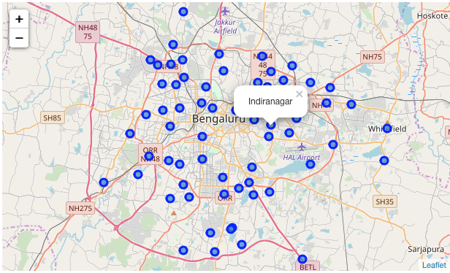
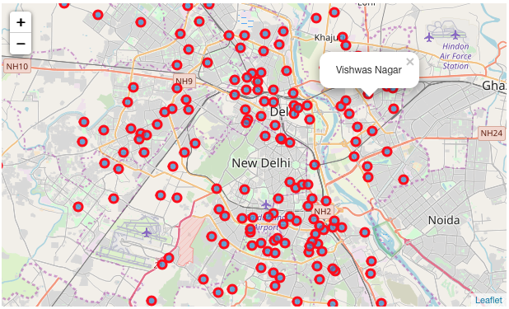
Methodology
The data was sorted into tables containing neighborhoods of Delhi and Bengaluru
All the neighborhoods were visualized on the map

Slide 6
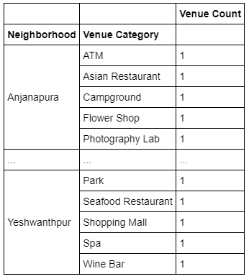
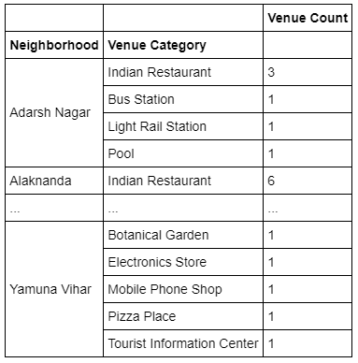
Data frames were created to better understand the different categories of services and the number of them located around each neighborhood

Slide 7
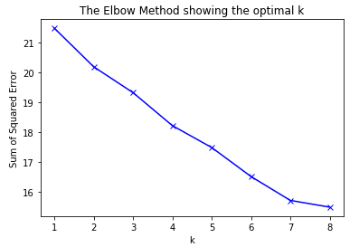
Optimum ‘K’ for K-Means was obtained using the Elbow method and then finding the Silhouette Coefficient

Slide 8
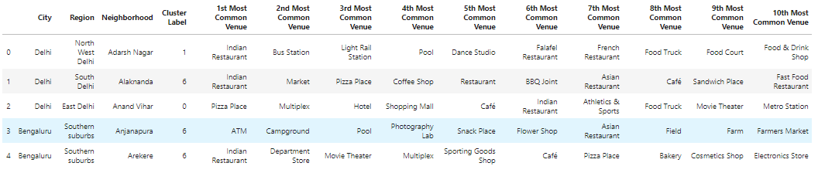
K-Means clustering was performed, and the neighborhoods were grouped into 7

Slide 9
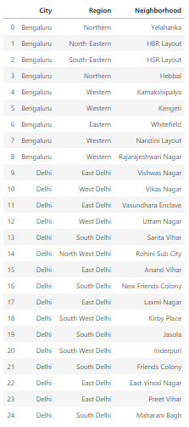
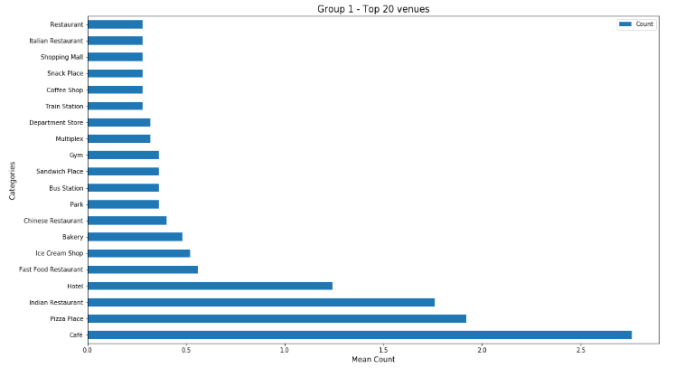
Each groups were listed with the Neighborhoods, City and Region.
Eg – Group 1
Graph showing average count of each venue category

Slide 10
Discussion
Indiranagar was found to be the neighborhood with most number of unique venue categories while Lodi Colony has the most in Delhi.
Both the cities were found to be comparable between their neighborhoods and the services they offer
People shifting between these cities can easily find a neighborhood they are similar to

Slide 11
Conclusion
The project turned out to offer an effective guide to compare the neighborhoods of two most developing metropolitan cities in India
The analysis was performed by only comparing the services each neighborhood has to offer. Though this is an important criteria, other factors such as traffic data, housing prices etc. can be used in the future studies for a better result

